Slide 1
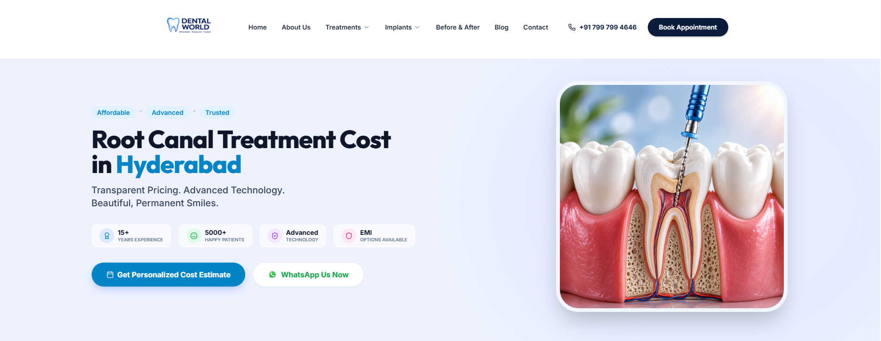
Know more

Slide 2
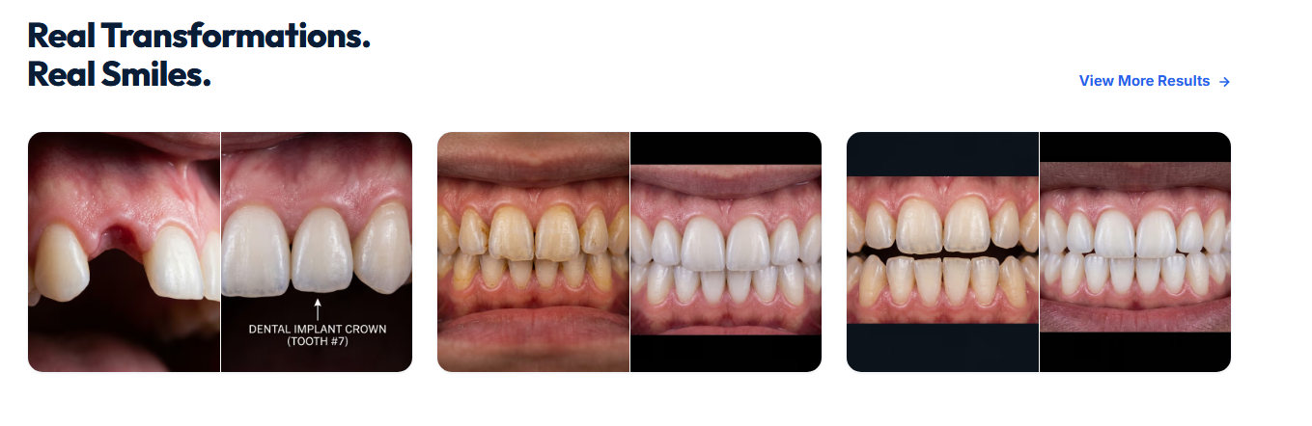

Slide 3


Slide 4
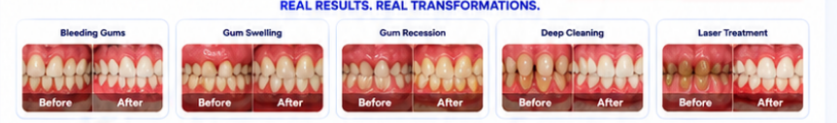
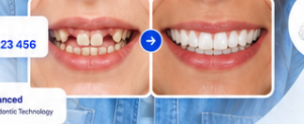
Bleeding gums landing page
Photos need to be replaced
Photo needs to be changed

Slide 5
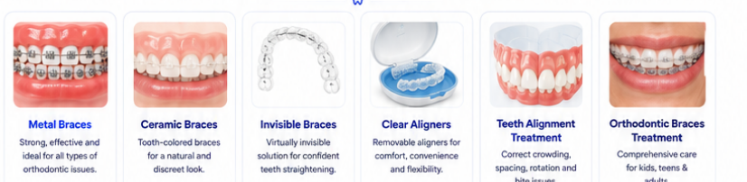
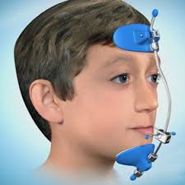
In braces landing page
Remove these 3. Other photos are ok.
Add one tile – title : myofunctional jaw corrections

